Slide 1

Blockchain Tycoon Presentation
Valtteri Hermonen, Iiro Toivanen

Slide 2
Goal of the project
Currently blockchain is a vague concept to most people
Introduce blockchains as a concept through a gamified simulation
Highlight the main components of a blockchain network
Create an effortless and enjoyable experience
Main goal is to create a game that can be further refined into a tool for educational purposes
Challenge ourselves to make a game

Slide 3
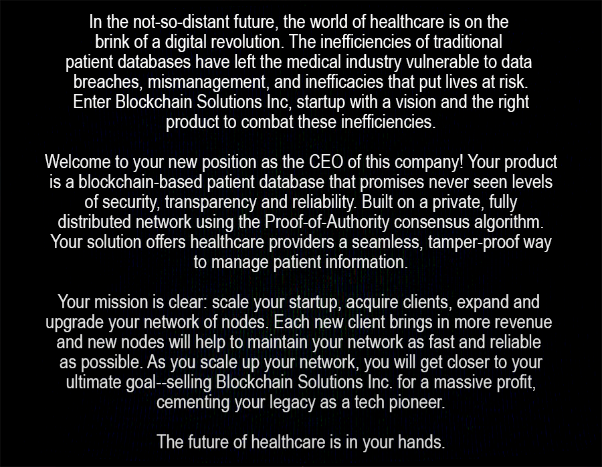
Game Idea
Employ blockchains to generate revenue
Once you have enough revenue, sell your company and win the game
A possible real-world example simplified into a game

Slide 4
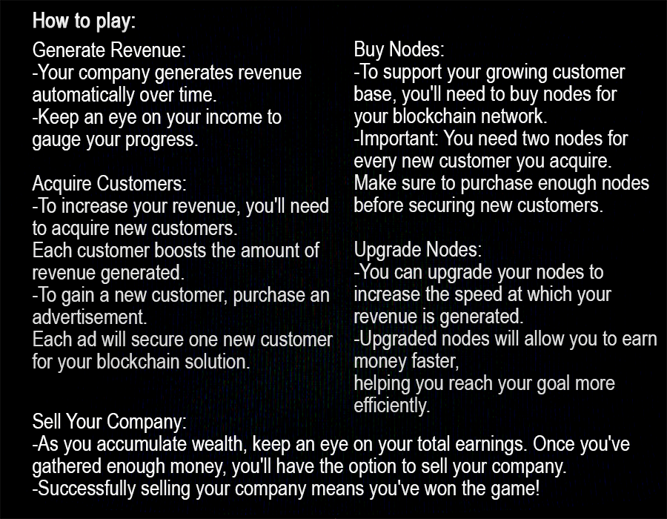
Game Mechanics

Slide 5
Technical Implementation
Project is using Java as its game engine
JavaFX framework to create graphical components
Codebase and other resources are stored in GitHub
Git as version control system
Graphical elements were created in Photoshop

